Slide 1
Chapter 8
Illumination

Slide 2
This Chapter
Understand the parameters of simple illumination models
Define infrastructure supports for working with multiple light sources
Understand the basics of diffuse reflection and normal mapping
Understand the basics of specular reflection and the Phong illumination model
Implement GLSL shaders to simulate diffuse and specular reflection and the Phong illumination model
Create and manipulate point, directional, and spotlights
Simulate shadows with the WebGL stencil buffer

Slide 3
Illumination Model
Math formulation: of energy transfer
to compute final color for an scene
Direct illumination: energy received from the source (light source)
Indirect (global) illumination: energy received from reflection
Important for games:
Basic aesthetic
Support dramatic effects:
Sense of Horror: Dark surrounding with only a torch light
Sense of Danger: flickering of red emergency lights
Realism: Only as important as games required
Surreal: e.g., negative light source (possible)!

Slide 4
Pathway of learning
Ambient Light: background light (secondary illumination)
Simple light sources: how energy leaves sources
Reflection models: how energy is reflected to the eye
Diffuse and Specular reflection models
Introduce the idea of “material property”
Light source types:
How to model different ways of energy leaving a source
Shadows: inter-object occlusion
A first pass approximation

Slide 5
Ambient Light
Objects are visible: even when all lights are switched off
Reason? Secondary illumination
Light sources that are not directly visible to the eye
Objects inter-reflect lights from sources
Characteristics
Smooth illuminated results (no sharp boundaries)
Color bleeds
Solution
Global illumination (Radiosity): Expensive
Our solution: approximate with constant! ☹

Slide 6
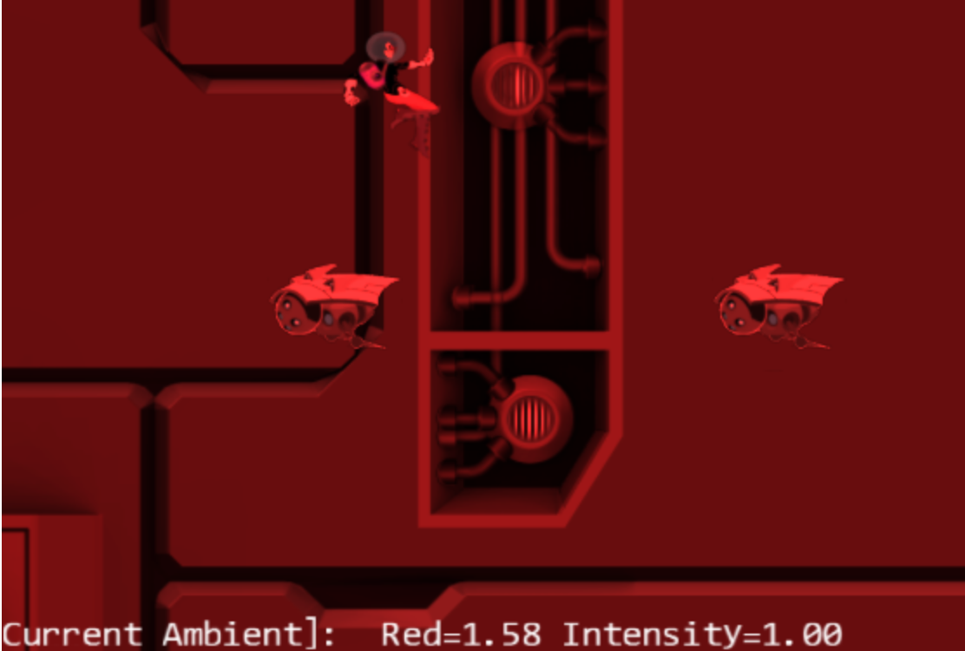
8.1: Global Ambient Project
LMB: Increases global red ambient
MMB: Decreases global red ambient
Left/right arrow keys: Decrease/increase global ambient intensity

Slide 7
8.1: Goals
experience the effects of ambient lighting
understand how to implement a simple global ambient across a scene
refamiliarize with the Shader/Renderable pair structure to interface to GLSL shaders and the game engine

Slide 8
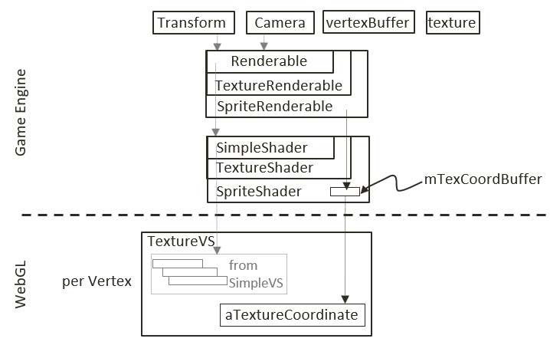
Review our GLSL Shader implementation
CPU to VS: transform to NDC
Vertex and Texture coordinates
Model + Camera Xforms
CPU to FS: compute pixel colors
Pixel Color + texture sampler
VS to FS
What is “varying”?
gl_Position + vTexCoord
Shader hierarchy
Interface (pass information) to GLSL
Renderable hierarchy
Allows game programmer to associate per-instance parameters
e.g., xform, texture, sprite info

Slide 9
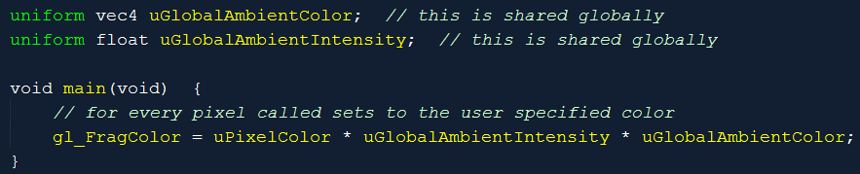
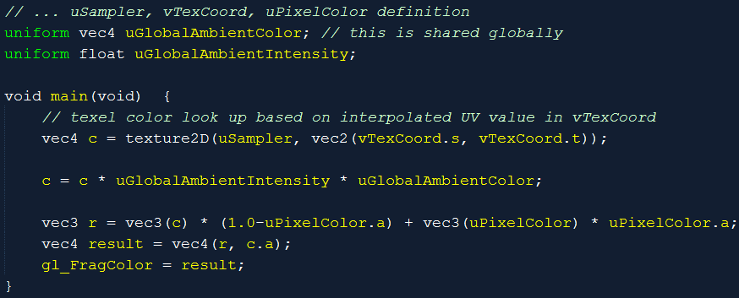
Fragment Shaders: SimpleFS/TextureFS
Separate intensity and color (for convenience)

Slide 10
Engine module: default resources
engine/resources/default_resources.js
Define mGlobalAmbientColor/Intensity
With accessors and setters

Slide 11
SimpleShader: to pass global intensity/color
Constructor:
mGlobalAmbientColorRef and mGlobalAmbientIntensityRef
Make sure to set the references to the shader uniform locations
activate()
Pass the global values from CPU to GPU

Slide 12
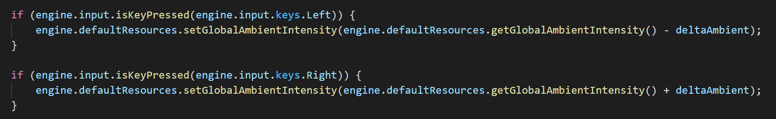
Testing
Left mouse button: Increases the global red ambient
Middle mouse button: Decreases the global red ambient
Left/right arrow keys: Decrease/increase the global ambient intensity
MyGame.update()

Slide 13
Observations
Color and Intensity (multiplied)
Values:
0 to 1 range is “legal”
BUT: can change to anything
Saturation and Over-saturation

Slide 14
Light Source: Source of energy!
Observe the lights around us
How to describe
Geometry of the source can be complex!
For now, focus on a light bulb (the simplest light source?)
A point light source
Later:
The Sun (directional light)
Desk lamp: Spotlight

Slide 15
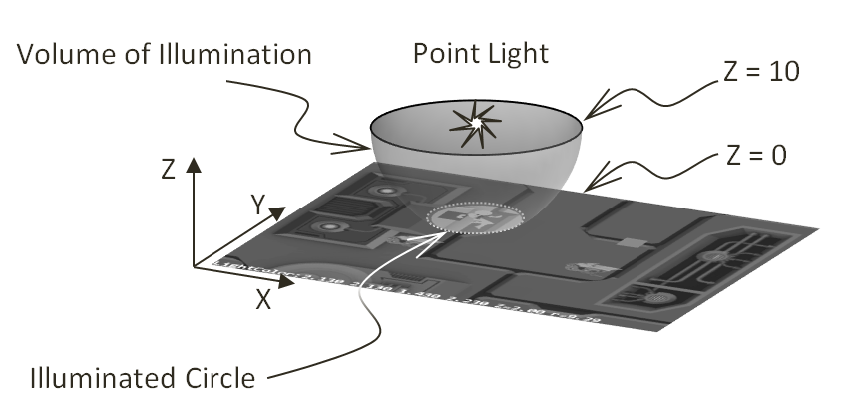
Point Light
Must work in 3D!
Illumination volume
A Sphere
Inside: On
Outside: Off
On 2D plane
Illuminates a circle

Slide 16
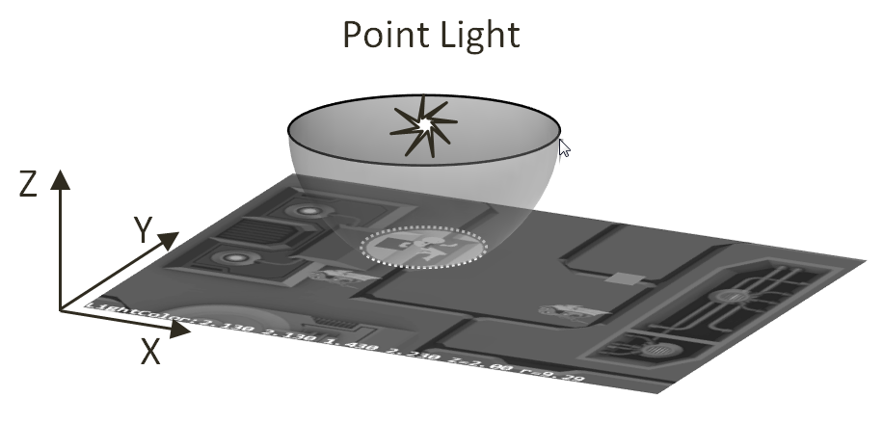
Parameters of a light:
Light On or Off
Light Radius
Light position:
In 3D! (with Z! ☺)
Z-value is important
Z == 0 is our world!
Light Color
All in Fragment Shader!
Only changes pixel value!

Slide 17
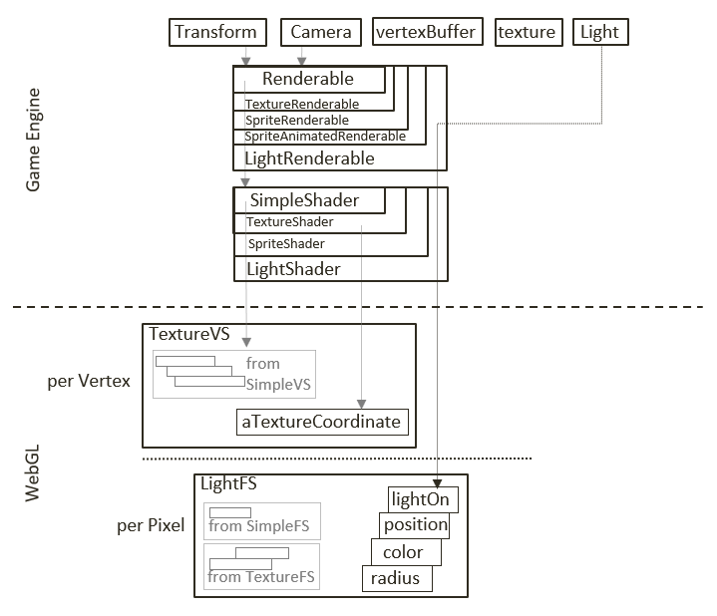
Implementation of light
Light parameters in Fragment Shader only
Use same TextureVS (why not SimpleVS?)
LightShader/LightRenderable to support light parameters

Slide 18
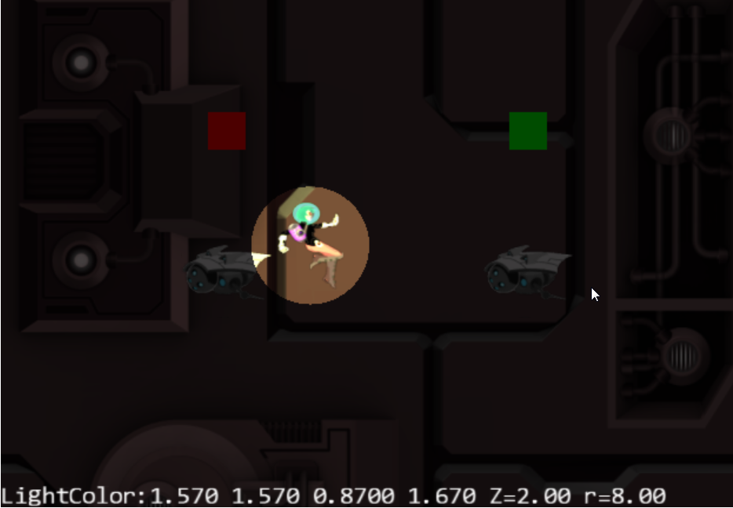
8.2: Simple Light Shader Project
WASD keys: hero
WASD keys + LMB: hero and light
Left/right arrow key: light intensity
Z/X key: light Z position
C/V key: light radius

Slide 19
8.2: Goals
understand how to simulate the illumination effects from a point light
experience illumination results from a point light
implement a GLSL shader that supports point light illumination

Slide 20
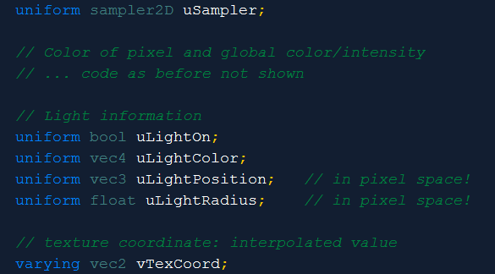
GLSL Fragment Shader: light_fs.glsl
The parameters
WATCH OUT!!
Position and radius
Values in pixel space!!?
You will see later!

Slide 21
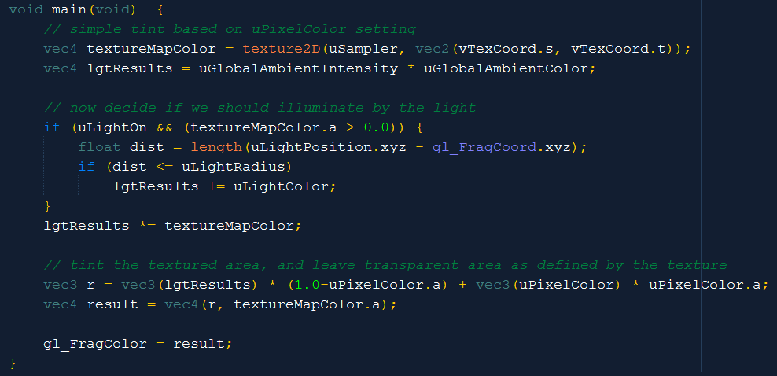
LightFS: the main()
Current pixel
Results in units of pixels

Slide 22
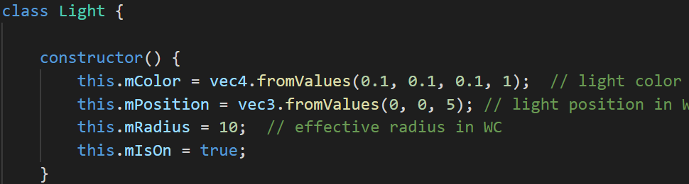
Define the Light object
One-to-one of the Fragment Shader parameters
Define: light_shader.js to
pass this information (of a light) to the Fragment Shader
Boring: setter/getter not shown

Slide 23
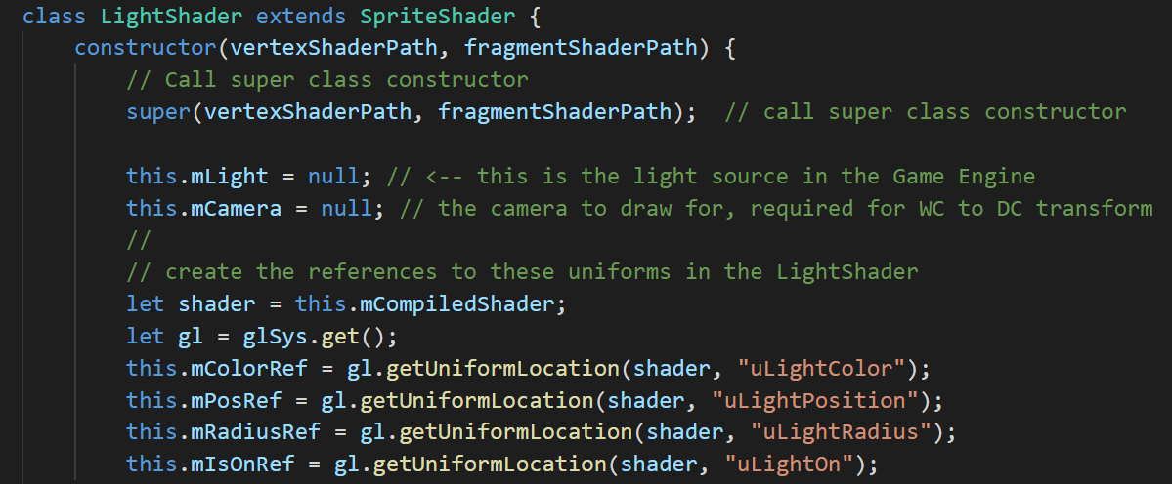
light_shader.js
Job: send the content to the Fragment Shader!
Connection to the attributes in the FS!
Connection to the attributes in the FS!

Slide 24
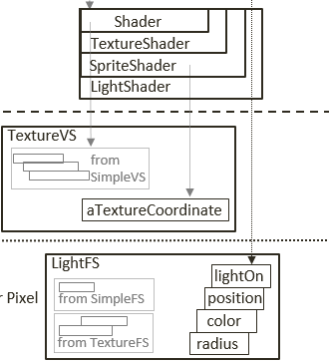
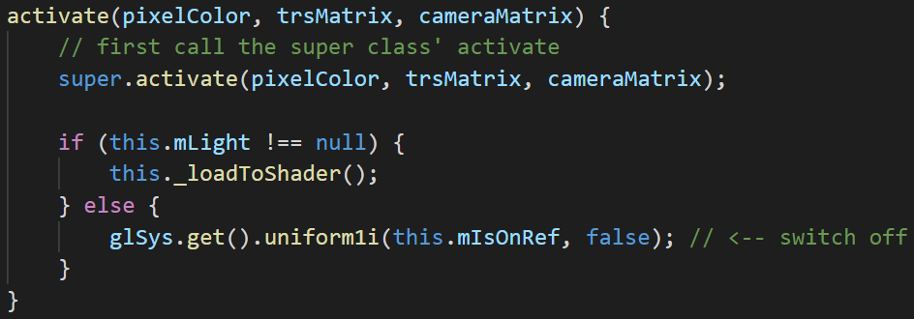
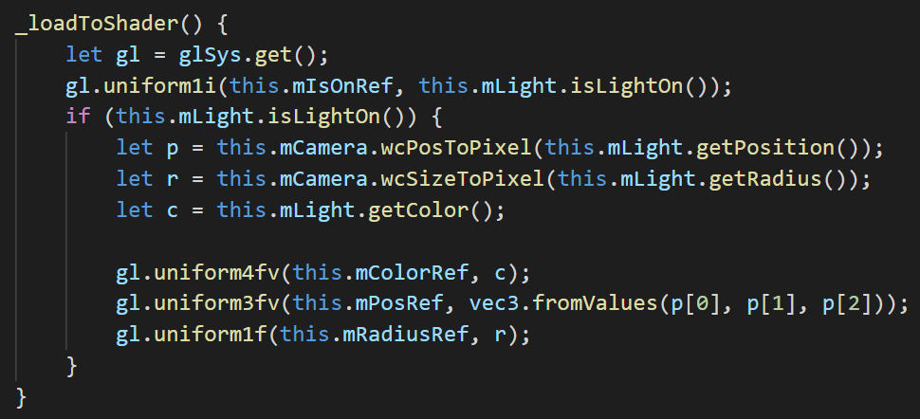
LightShader.activateShader()
All positions and size in pixel space!

Slide 25
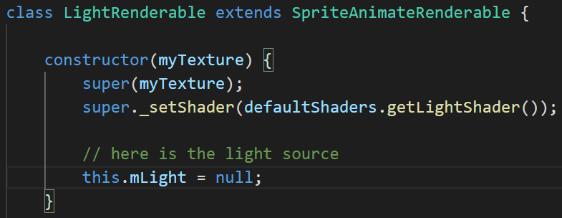
LightRenderable: for Game Programmer
mLight: is the only addition to SpriteAnimateRenderable

Slide 26
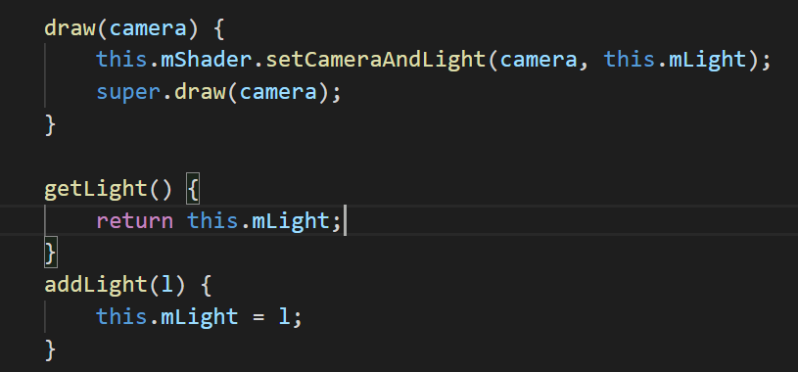
LightRenderable: draw and setLight
Draw: sets the light and camera (for to DC transform)
Remember: LightShader is shared!

Slide 27
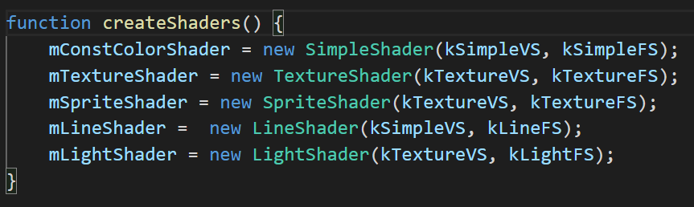
core/shader_resoruces.js
Define a mLightShader
With getter/access for engine-wide sharing
Note: re-use kTextureVS!

Slide 28
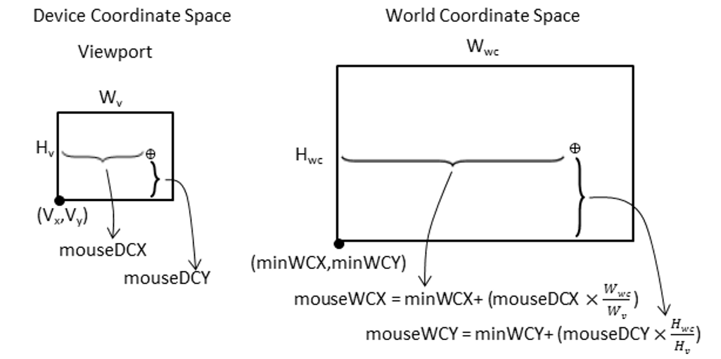
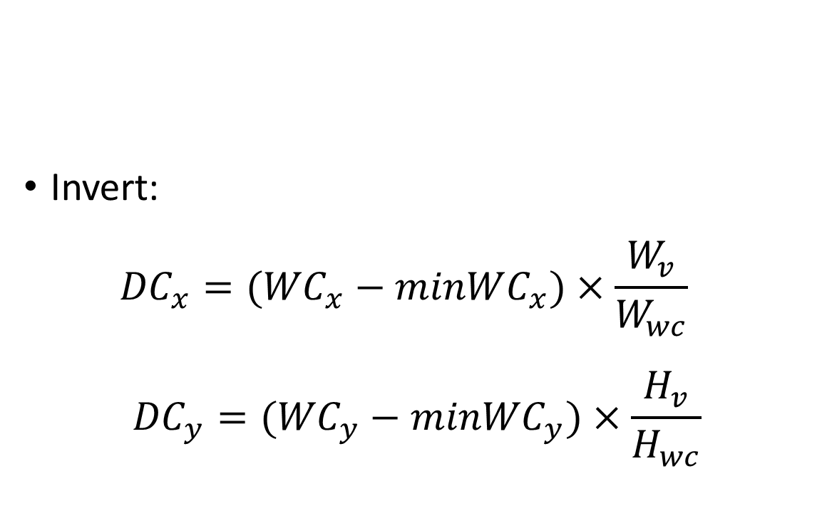
Pixel Space!! (From WC)
Invert: ${DC}_{x}=({WC}_{x}−{minWC}_{x})×\frac{W_{v}}{W_{wc}}$
$${DC}_{y}=({WC}_{y}−{minWC}_{y})×\frac{H_{v}}{H_{wc}}$$

Slide 29
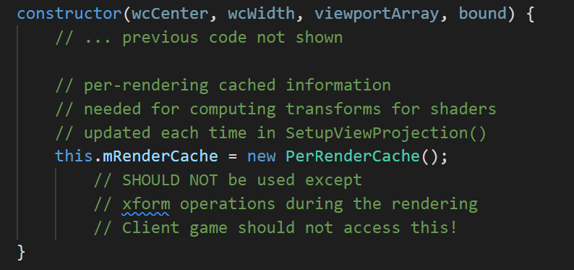
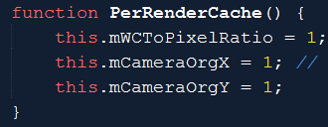
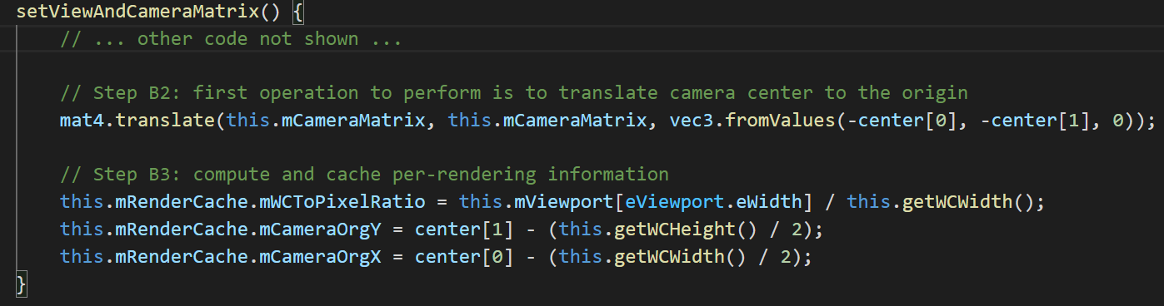
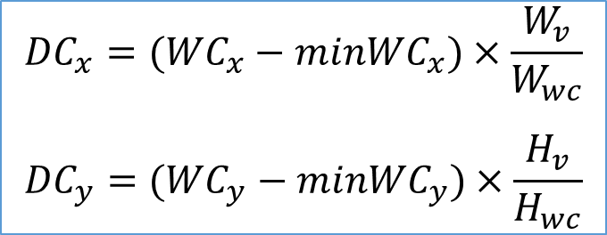
Computation in Pixel Space!
Avoid per-object re-computation
camera_main.js
$${DC}_{x}=({WC}_{x}−{minWC}_{x})×\frac{W_{v}}{W_{wc}}$$
$${DC}_{y}=({WC}_{y}−{minWC}_{y})×\frac{H_{v}}{H_{wc}}$$

Slide 30
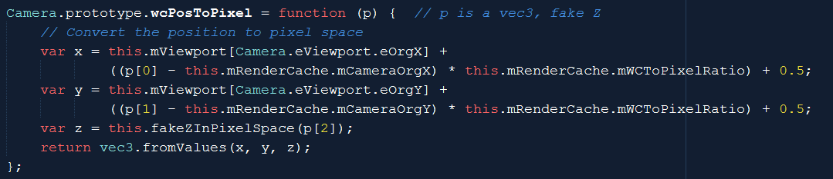
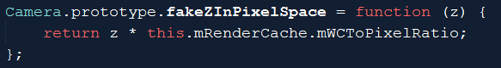
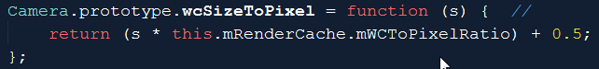
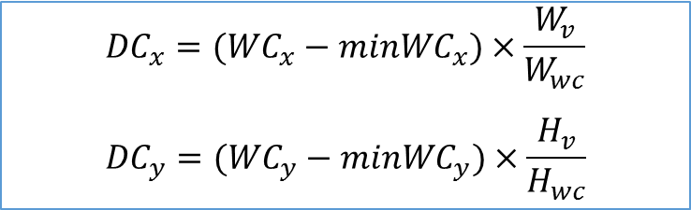
camera_xform.js: transform support
$${DC}_{x}=({WC}_{x}−{minWC}_{x})×\frac{W_{v}}{W_{wc}}$$
$${DC}_{y}=({WC}_{y}−{minWC}_{y})×\frac{H_{v}}{H_{wc}}$$

Slide 31
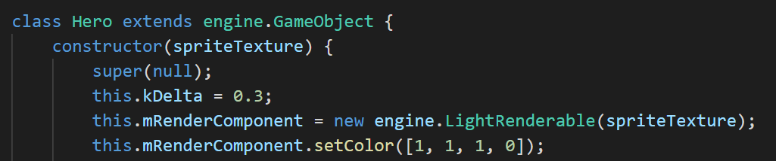
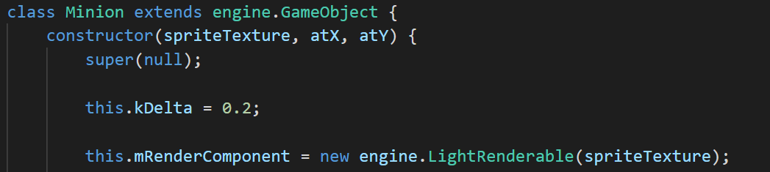
Objects in MyGame …
Hero: reference to LightRenderable
Minion: also reference to LightRenderable
LightRenderable: subclass from SpriteAnimateRenderable
➔Light shine on animated object!

Slide 32
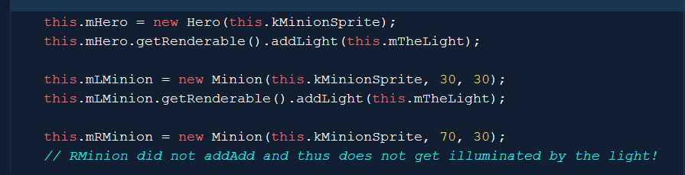
Testing the light with MyGme
Add the light to Hero and Left-Minion
BUT not Right-Minion
my_game_main.js
init() function

Slide 33
Observe:
WASD keys + LMB:
Move to Left-Minion➔ Illuminated!
Move to Right-Minion, not illuminated (no light)!
Left/right arrow key: observe light increase/decrease
Z/X key: light Z position
Can move light to the negative plane!
There is a max illuminated circle size (radius of the light)
C/V key: light radius
Illuminated circle size can grow to anything!

Slide 34
More observation
Cool?
Light illumination is pretty cool?
No Cool!
Very restrictive, only one light!
Light does not model a light bulb?!

Slide 35
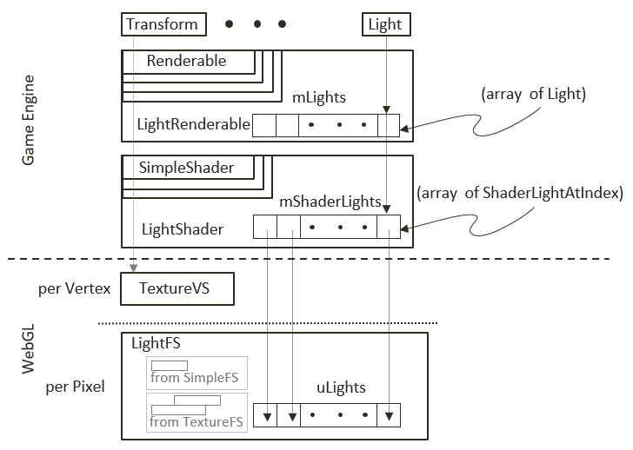
Multiple Light Sources
Fragment shader with an Array of Light!

Slide 36
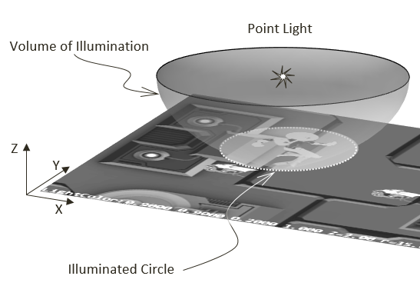
Compare to a light bulb:
Illuminated circle boundary
Should be soft (gradual) light energy dies off according to distance
Distance Attenuation
Implementation:
Near/Far cutoff
<Near: all illuminate
>Far: no illuminate
In between: drops of gradually

Slide 37
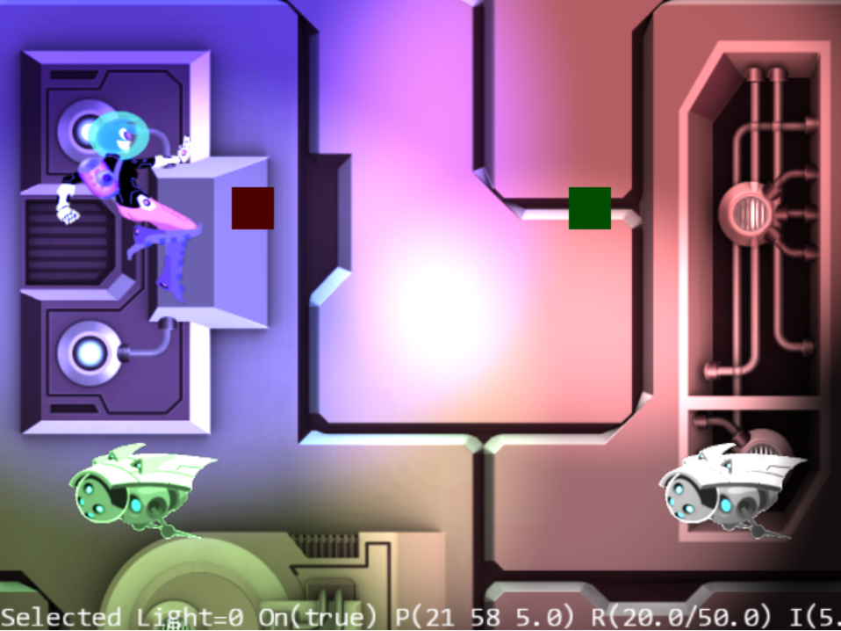
8.3: Multiple Lights Project
WASD: hero
0-3: Select light
Arrow: Selected light
Z/X: light z position
C/V: near cut-off
B/N: far cut-off
K/L: intensity
H: Toggles on/off

Slide 38
8.3: Goals
build infrastructure to support multiple light sources
in the engine and in GLSL shaders
understand and examine the distance attenuation effects of light
experience controlling and manipulating multiple light sources in a scene

Slide 39
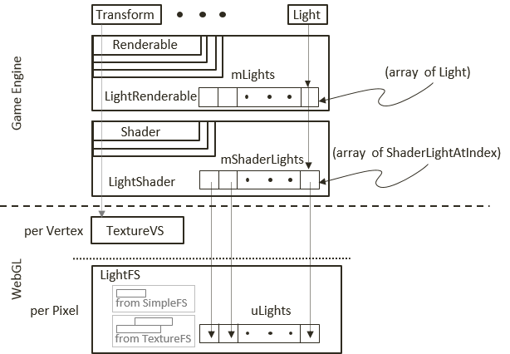
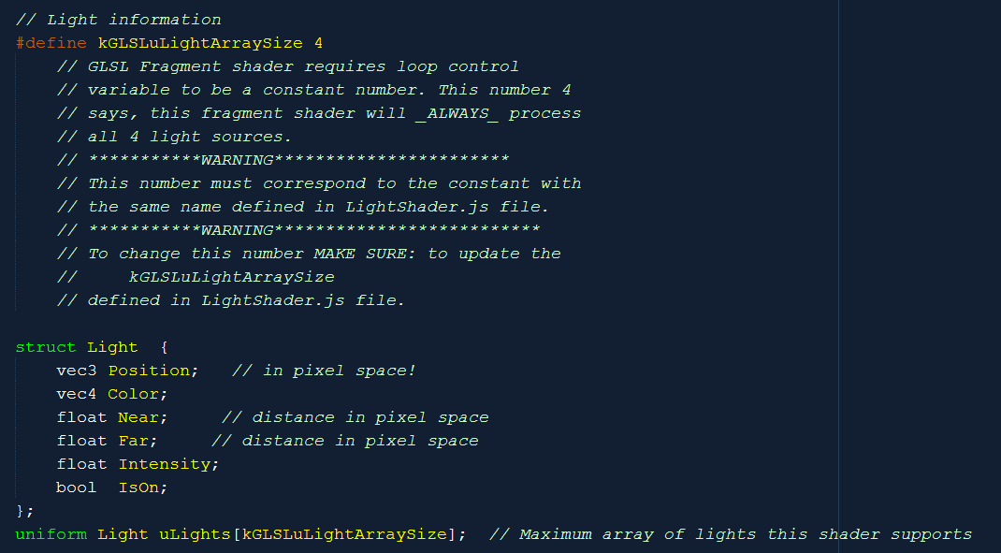
light_fs.glsl: Array support!
Must be the same size!
Must be the same size!
Must be the same size!

Slide 40
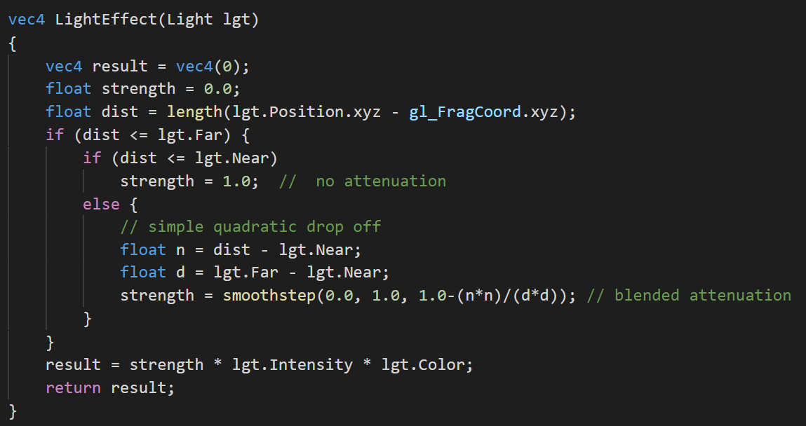
Compute lightEffect

Slide 41
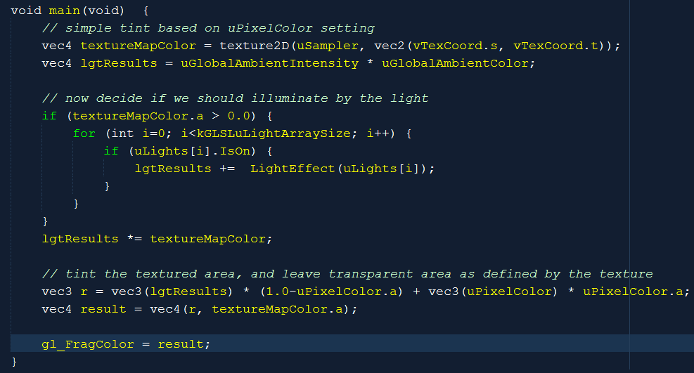
LightFS: The Light Fragment Shader
Loop control must be a constant!
At runtime, cannot decide how many to loop over! Must loop over lights even if they are switched-off!

Slide 42
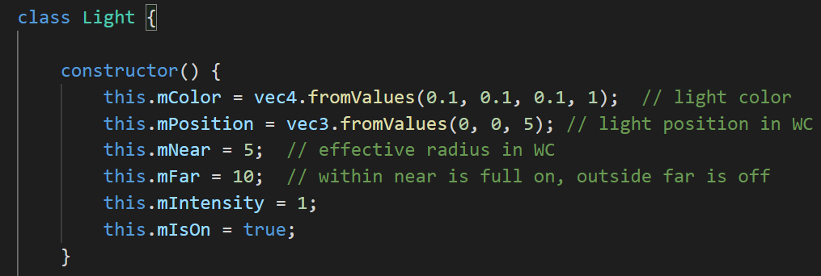
light.js: with cut-offs
Boring setter/getter: not shown

Slide 43
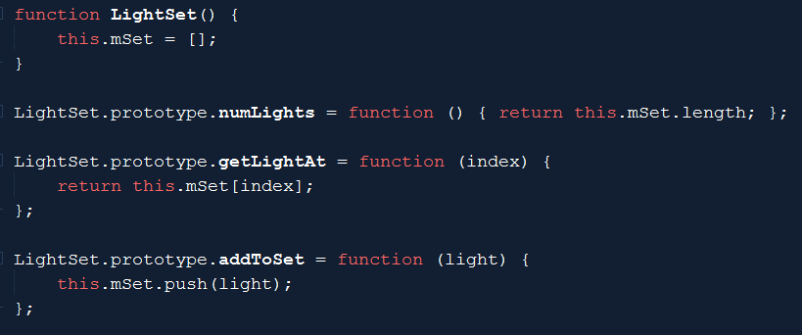
LightSet

Slide 44
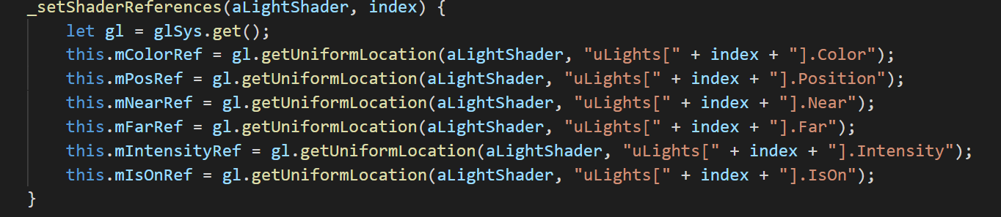
ShaderLightAt
To communicate to LightFS
Each ShaderLightAt is connected to one uLights[] array element!
References for one light (specific index)
shader_light_at.js

Slide 45
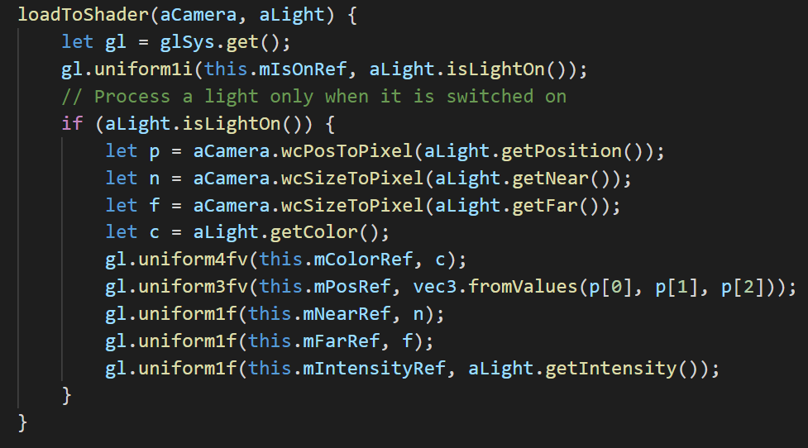
ShaderLightAt::loadToShader()
loads one light (for specific index)
shader_light_at.js

Slide 46
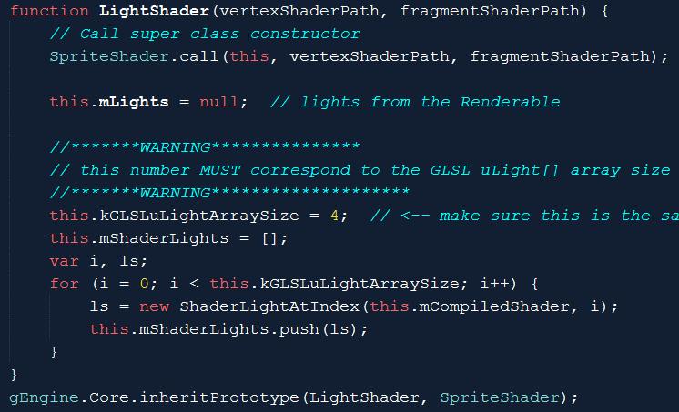
LightShader.js

Slide 47
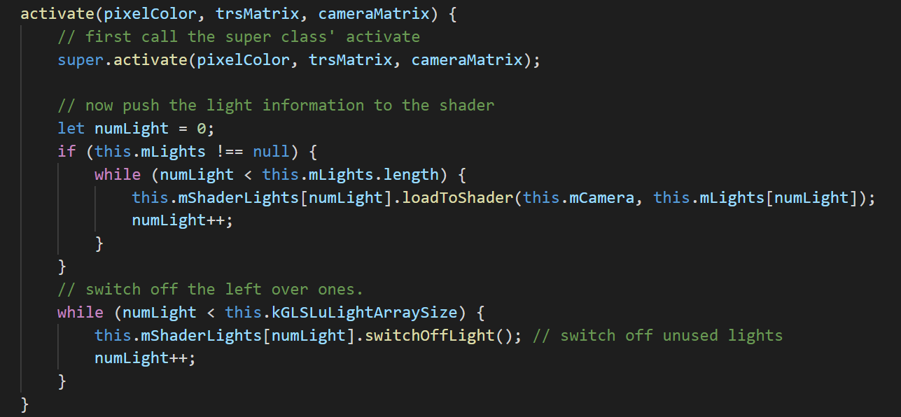
LightShader.activateShader()
Loads all defined lights to the fs shader
Must switch-off un-used lights!
LightFS will loop through all uLights[] for each pixel!

Slide 48
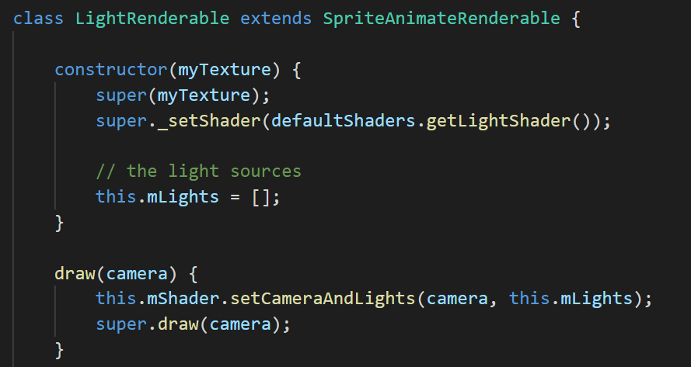
LightRenderable

Slide 49
Observation:
Multiple lights
Cool!?
Distance attenuation: softer more gentle effects
More like real world?
The entire world appears flat!?
Lack of sense of object geometric shape/contour?

Slide 50
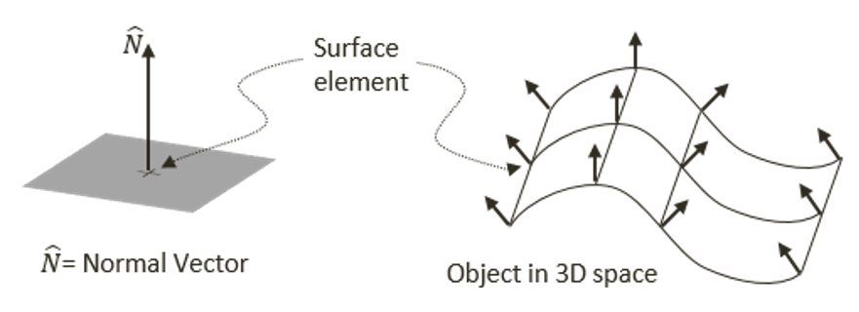
2D World: Objects (images) without contour!
Lack of Normal vector! (in 3D)

Slide 51
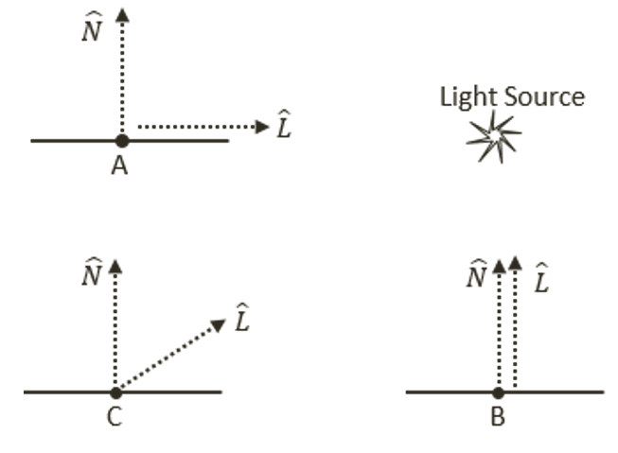
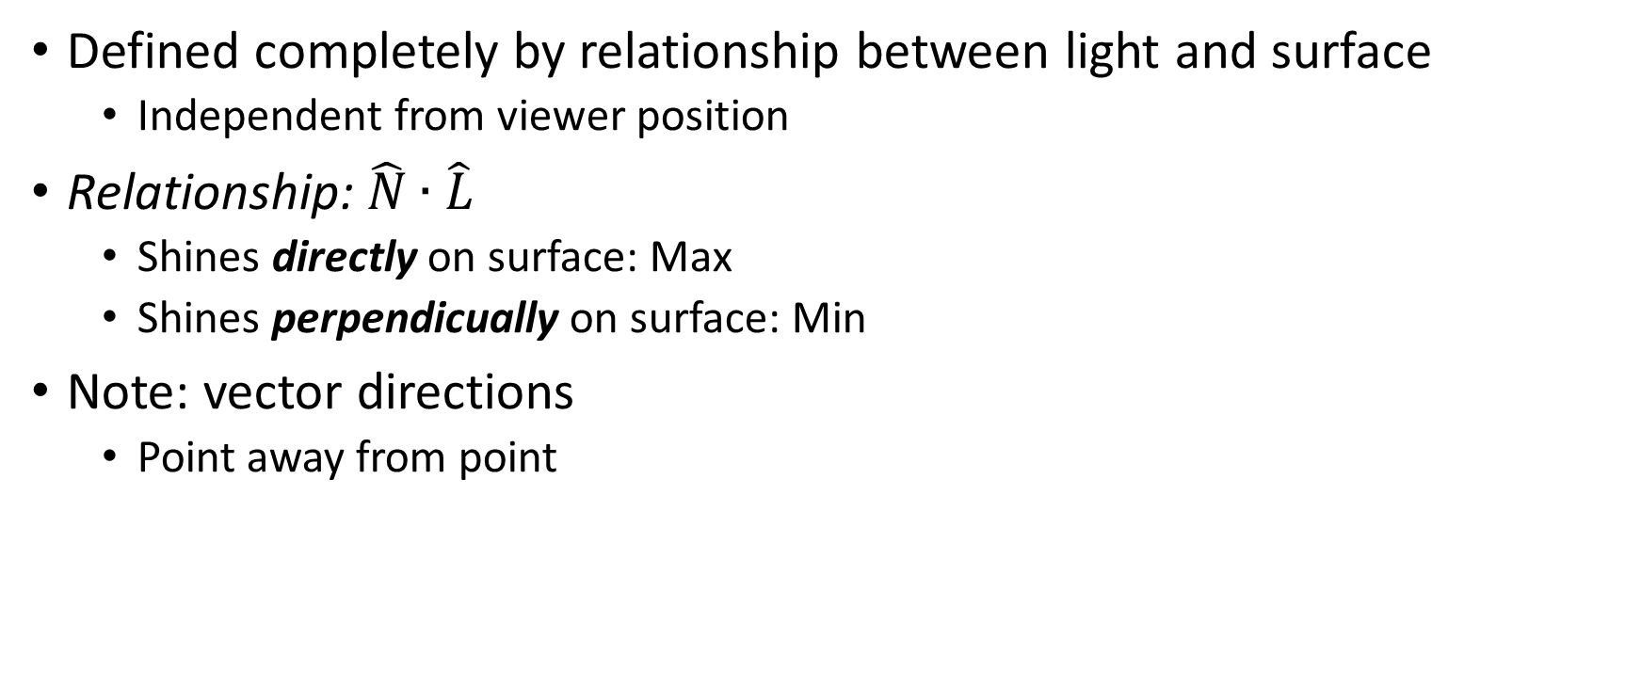
Diffuse Reflection
Defined completely by relationship between light and surface
Independent from viewer position
Relationship: $\hat{N}∙\hat{L}$
Shines directly on surface: Max
Shines perpendicually on surface: Min
Note: vector directions
Point away from point

Slide 52
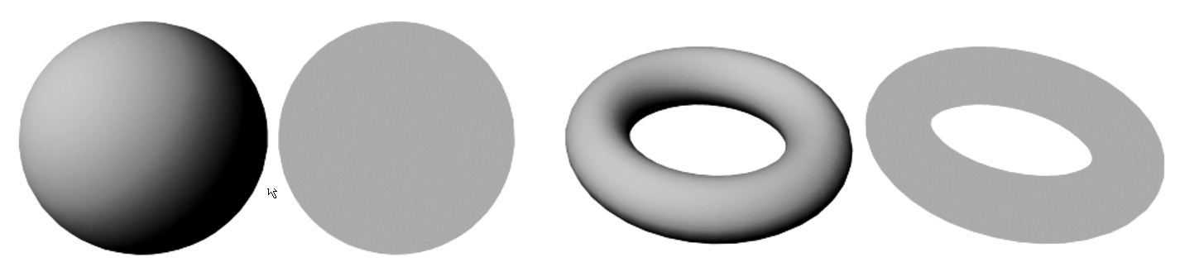

Diffuse vs constant color
$\hat{N}∙\hat{L}$ vs. A simple constant color

Slide 53
Implementation in 2D world
Everything is flat!
Texture mapping:
Given a pixel position: what value to use to represent an object’s attribute
Color texture mapping:
What color to use to represent an object’s appearance (material property)
Implementation: read 4 floats, pretend is RGBA, use a color for object
Normal texture mapping:
What normal vector to use to represent an object’s geometric contour
Implementation: read 3 floats, pretend is XYZ of object surface normal!

Slide 54

Working with a Normal Map
Two texture maps!
A Color Map
Worked with this!
A Normal Texture Map
Drawn explicitly by artists
Computed/Approximated: e.g., http://cpetry.github.io/NormalMap-Online/

Slide 55


Surface normal elements

Slide 56

Details
$\hat{N} …$Normal map: 3 floats texel T = (x, y, z)
Each is normalized range (0 to 1)
Transform into -1 to +1: $\hat{N}$ = 2 * [ T – (0.5, 0.5, 0.5) ]
Know how to sample a texture based on UV values
$\hat{L}$ computed using light source and fragment positions
$\hat{N}∙\hat{L}$ : this is the
Diffuse computation
Diffuse term

Slide 57

8.4: Normal Maps and Illum Shaders Project

Slide 58

8.4: Goals
To understand and work with normal maps
To implement normal maps as textures in the game engine
To implement GLSL shaders that support diffuse component illumination
To examine the diffuse component illumination of $\hat{N}∙\hat{L}$

Slide 59




8.4: Normal maps
Drawn by artist:
Generated on-line (http://cpetry.github.io/NormalMap-Online/ )

Slide 60
Implementation overview
GLSL shader: to sample Normal and Color texture maps
IllumShader: to pass in the appropriate info
TextureShader: updated to work with 2 texture maps simultaneously
IllumRenderable: to support man instances of Renderable objects
Engine update:
DefaultResource: define new instance of IllumShader
Texture: support work with 2 texture maps simultaneously
Testing

Slide 61

GLSL Illumination Shader: illum_fs.glsl
Define a new sampler2D (for normal map):
illum_fs.glsl

Slide 62

Illum_fs.glsl: LightEffect
New parameter
Diffuse computation

Slide 63

Illum_fs.glsl::main() sample of Normal Texture
Read from normal map using same UV as color texture map
May need to flip y-direction
Use in LightEffect() computation

Slide 64


Illum_shader.js: conduit to the NormalMap
Texture unit 1: used for normal map. GLSL: can have many units active at the same time (e.g., 32 units active at the same time!)

Slide 65

IllumRenderable: for Renderable objects

Slide 66

core/shader_resources.js
Create IllumShader
Can still reuse kTextureVS
why?
Remember to cleanUp
Again! Using kTextureVS vertex shader

